Slide 1
Introduction to Machine Learning
Nikhil Thota
Dec 5th 2022

Slide 2
Artificial Intelligence, Machine Learning and Deep Learning
Artificial Intelligence
Machine
Learning
Deep
Learning

Slide 3
Artificial Intelligence, Machine Learning and Deep Learning
Theory and development of computer systems to perform tasks requiring human intelligence [1]
Artificial Intelligence
Can machines think ? [1]
Symbolic AI
Expert Systems
Symbolic AI : Collection of methods that carry out logical reasoning by symbolic representations of problems. [2]
Machine
Learning
Neuro
Symbolic AI
Expert Systems : Computer programs that emulate human decision making through large bodies of conditional statements (Rule based systems)
Deep
Learning
Neuro-symbolic AI : Combines strength of symbolic AI with deep learning architectures.[3]
[1] Turing, A. M. I.—COMPUTING MACHINERY AND INTELLIGENCE. Mind LIX, 433–460 (1950).
[2] Russell, S. J., Norvig, P. & Davis, E. Artificial intelligence: a modern approach. (Prentice Hall, 2010).
[3] Garnelo, M. & Shanahan, M. Reconciling deep learning with symbolic artificial intelligence: representing objects and relations. Current Opinion in Behavioral Sciences 29, 17–23 (2019).
Notes:
Can machines think ?
Famous question posed by Alan Turing in his 1950 paper Computing Machinery and Intelligence.
Introduces Turing test, early concepts of genetic algorithms and reinforcement learning.
He writes the word think and machine are too ambiguous and general. He goes on to formulate another question which is related to the first question but is expressed in unambiguous words.
This new question can be described through a game called the ‘Imitation game’.
It involves a man (A), a woman(B) and an interrogator (C) who may be of either gender.
Interrogator © stays in a room separate from the other two. The interrogator knows the two ppl by labels X and Y and it is the objective of the interrogator to predict which of the other two is a man (A) and which is the woman (B).
Now if suppose ‘A’ is male and ‘B’ is female, it is the job of A to confuse the interrogator and trick the interrogator into predicting that A is female and B is male.
It is the job of ’B’ to assist the interrogator into making the right prediction maybe by saying I am female and ‘A’ is male but ‘A’ can revert and say that I am female and ‘B’ is male.
Now we can reformulate the above question as “What will happen if machine takes the place of ‘A’?” “Will the interrogator decide wrongly as often when the game is played like this as he does when the game is played between a man and a woman ?”
OpenAI GPT Chatbot : https://chat.openai.com/auth/login
Artificial Intelligence :
Symbolic AI
Encompasses approaches that do not involve learning. For a long time experts believed human level intelligence could be obtained by crafting a large set of explicit rules. This was called Symbolic AI. Dominant paradigm from 1950 to 1980 until overtaken by machine learning and deep learning.
Symbolic AI was useful in cases where all the rules governing the process are known and can be logically coded using symbols and relations.
In cases where a fixed set of explicit rules cannot be determined symbolic AI fails. (Ex: Image classification, language translation, speech recognition).
However there is a resurgence in symbolic AI and attempt to reconcile symbolic AI with deep learning to combat the short comings of deep learning such as poor interpretability and generalization, data inefficiency (requires large volumes of data to achieve super human intelligence)

Slide 4
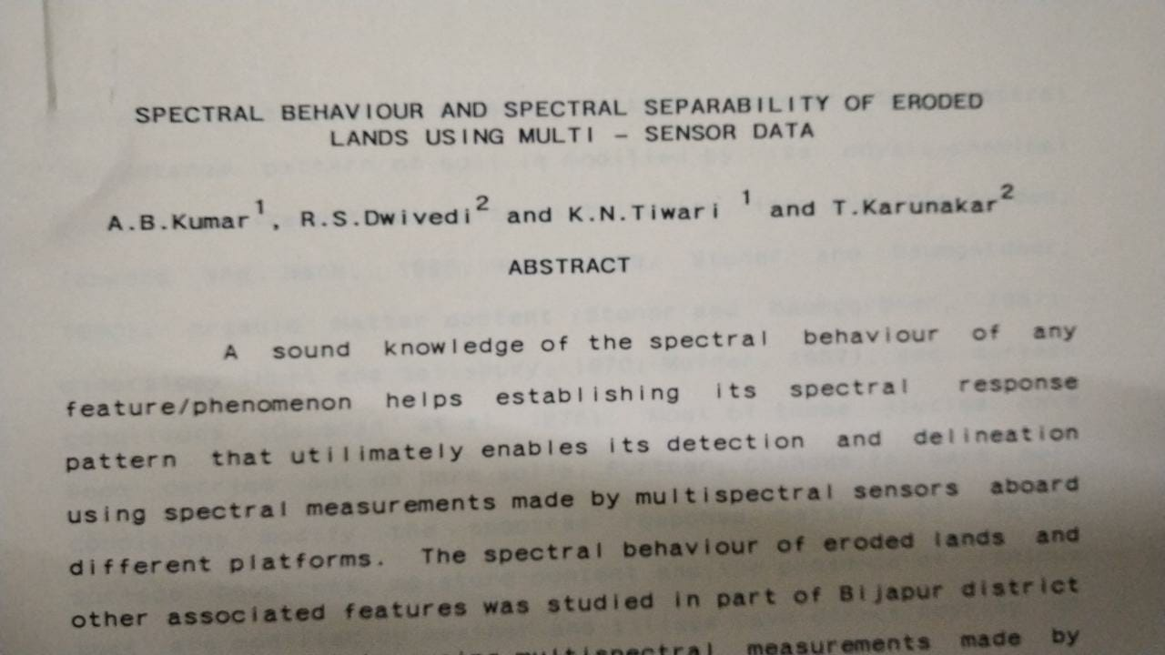
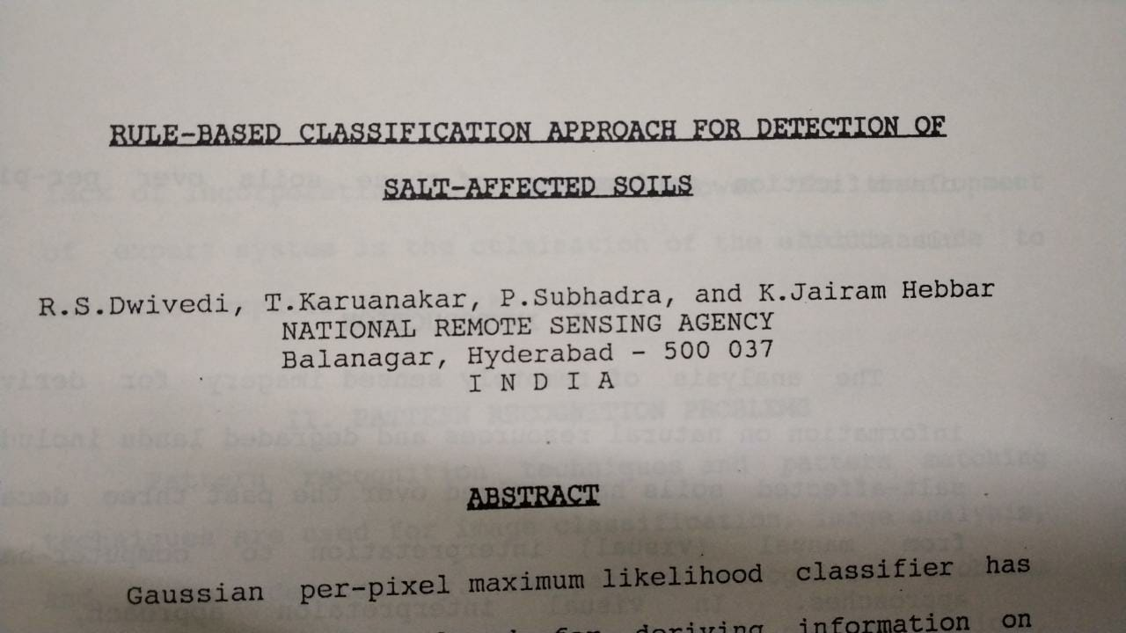
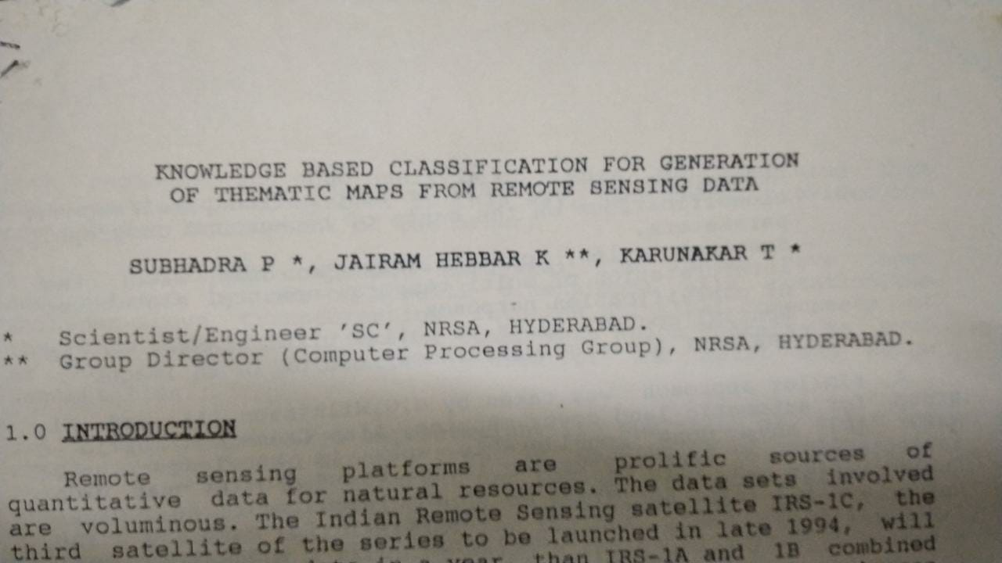
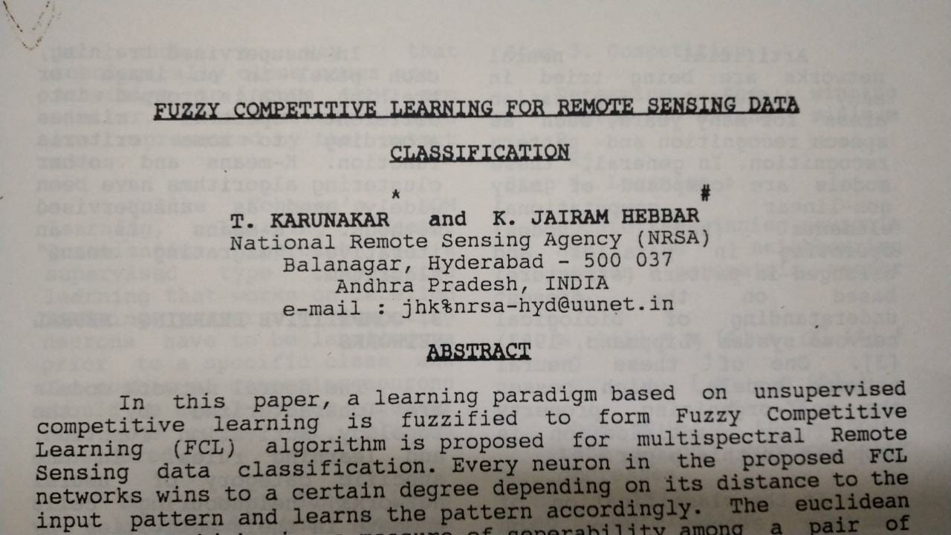
Notes:
1990s papers on using methods from machine learning and AI in remote sensing data. (Process of monitoring and the detecting physical characteristics of an area by measuring the emitted and reflected radiation typically from satellites)

Slide 5
Artificial Intelligence, Machine Learning and Deep Learning
Use and development of computer systems that are able to learn and adapt without following explicit instructions. (Oxford dictionary)
Artificial Intelligence
IMPORTANT ML LINGO
Symbolic AI
Expert Systems
Feature : Measurable property
Fuzzy Logic
Machine
Learning
Labels : Value associated with a feature or set of features
Dataset : Set of features and labels.
Neuro
Symbolic AI
Training set : Set of features and labels the model is trained on.
Test set : Set of features and labels that we use to evaluate the model predictions.
Deep
Learning
Hyperparameters : Model parameters

Slide 6
Artificial Intelligence, Machine Learning and Deep Learning
Task : Predict the number of fruits sold
Fruit (Feature 1) | Day of week (Feature 2) | Price (in $) (Feature 3) | Num sold (Label)
‘apple’ | ‘Monday’ | 1 | 20
‘banana’ | ‘Monday’ | 0.30 | 20
‘apple’ | ‘Tuesday’ | 1 | 10
‘pear’ | ‘Wednesday’ | 1.5 | 5
‘oranges’ | ‘Thursday’ | 1.5 | 10
Artificial Intelligence
Symbolic AI
Expert Systems
Training Set
Fuzzy Logic
Machine
Learning
Test Set
Neuro
Symbolic AI
Note :
A machine learning algorithm can only work with numerical data.
Need to convert all the categories of fruits and days of weeks into numerical vectors (One hot encoding)
Deep
Learning

Slide 7
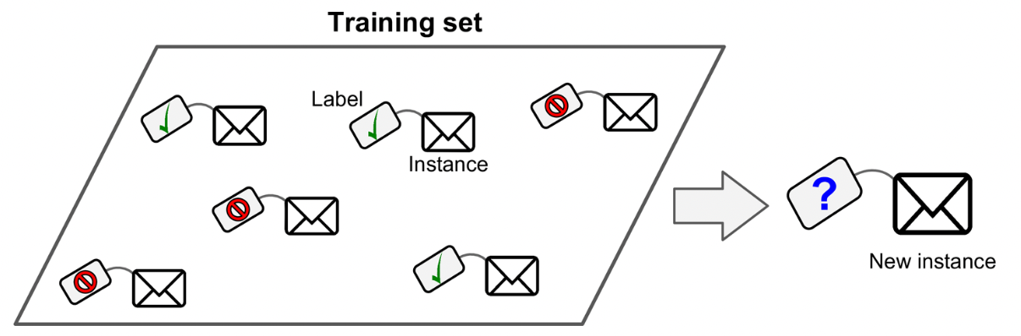
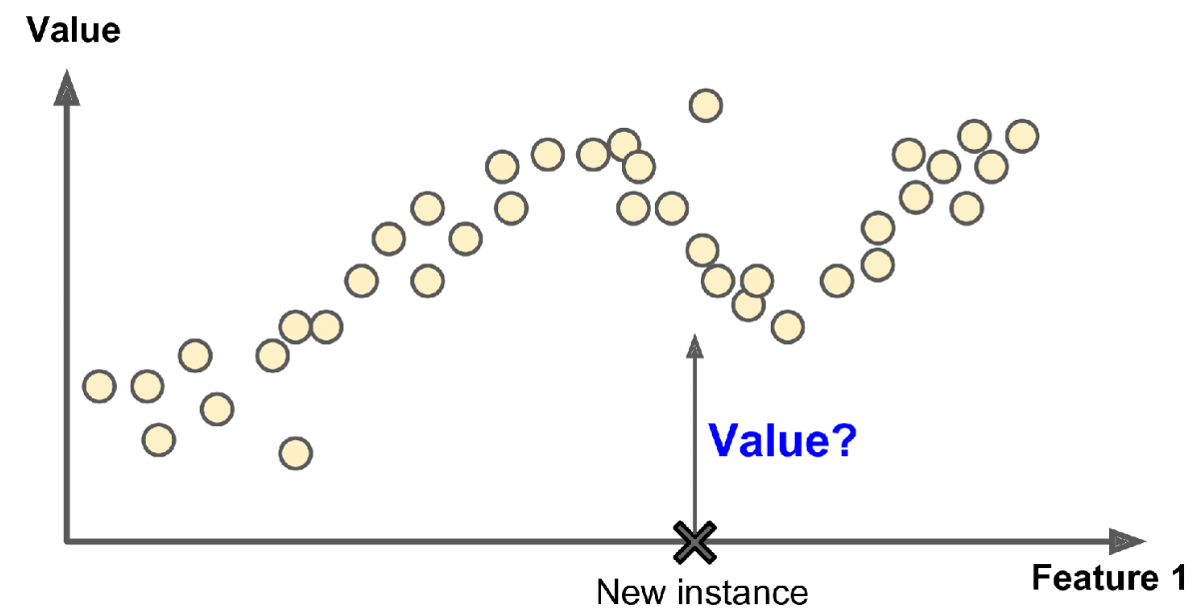
Artificial Intelligence, Machine Learning and Deep Learning
Supervised Learning
Classification
Artificial Intelligence
Symbolic AI
Expert Systems
Machine
Learning
Fuzzy Logic
Regression
Neuro
Symbolic AI
Unsupervised
learning
Reinforcement
learning
Supervised
learning
Deep
Learning
[1] Géron, A. Hands-On Machine Learning with Scikit-Learn, Keras, and TensorFlow. 1150.
Notes:
Machine Learning :
Supervised Learning
An analogy to supervised learning is where the teacher (i.e you) teaches the student (i.e the computer) what is the right answer.
Supervised learning typically involves performing either or both classification or regression.
The goal of classification is to predict the class a feature or set of features belong to. The example shown is for a spam filter which classifies email into two classes (‘spam’ or ‘not spam’). Here the contents of the email would be the features and the class is the label. The model essentially learns a decision boundary that separates the feature space into the two classes.
The goal of regression is to predict a numeric value for a given feature or set of features. In the example shown we have a set of points for each of which we have the corresponding label/value. This is our training set. We want to train the model to predict the value at a new instance. The model learns a function to fit the given data. Using this learned function, the model can essentially predict the value for any new instance.

Slide 8
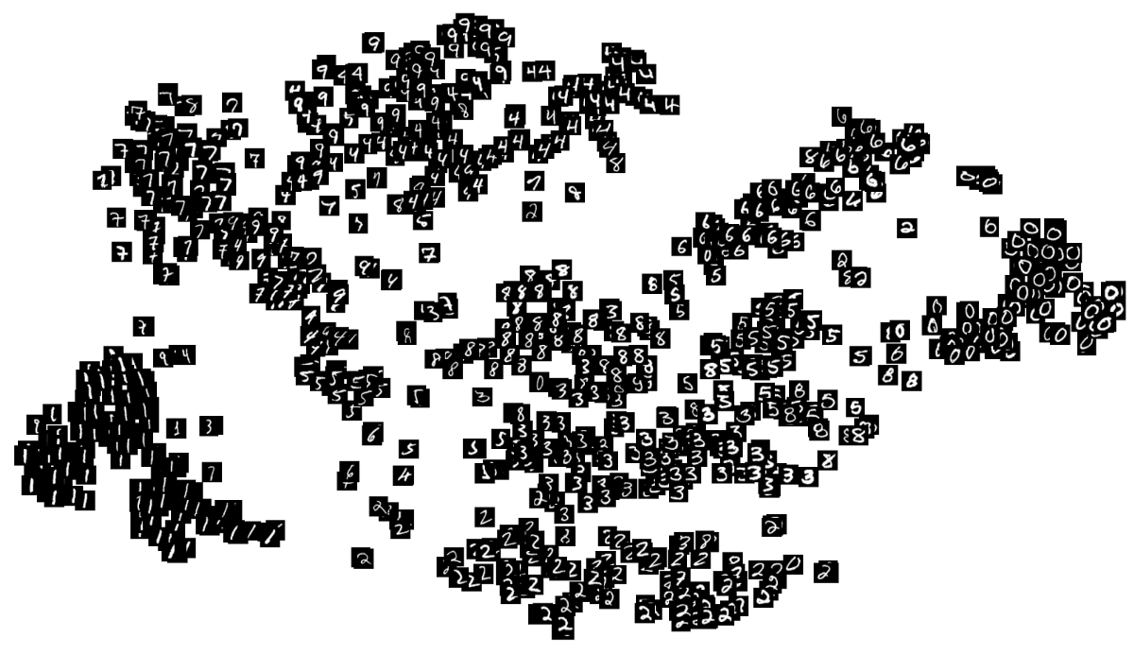
AI, Machine Learning and Deep Learning
Unsupervised Learning
Artificial Intelligence
Symbolic AI
Expert Systems
Machine
Learning
Fuzzy Logic
Neuro
Symbolic AI
Unsupervised
learning
Reinforcement
learning
Supervised
learning
Deep
Learning
Notes:
Machine Learning :
Unsupervised Learning
An analogy to Unsupervised Learning is where we ask the student(i.e computer) to identify relevant patterns in the data without providing it any labels.
In the example shown we train the model on a set of images of handwritten numbers 0-9 and we give it the take segregate the images into different classes. Note we are not specifying explicitly what number each image corresponds to. The model learns to segregate images into different classes based on the way each number is written.
Unsupervised learning useful in cases where we want to learn patterns from a large amount of data but we may not have labels for all the features in the dataset.

Slide 9
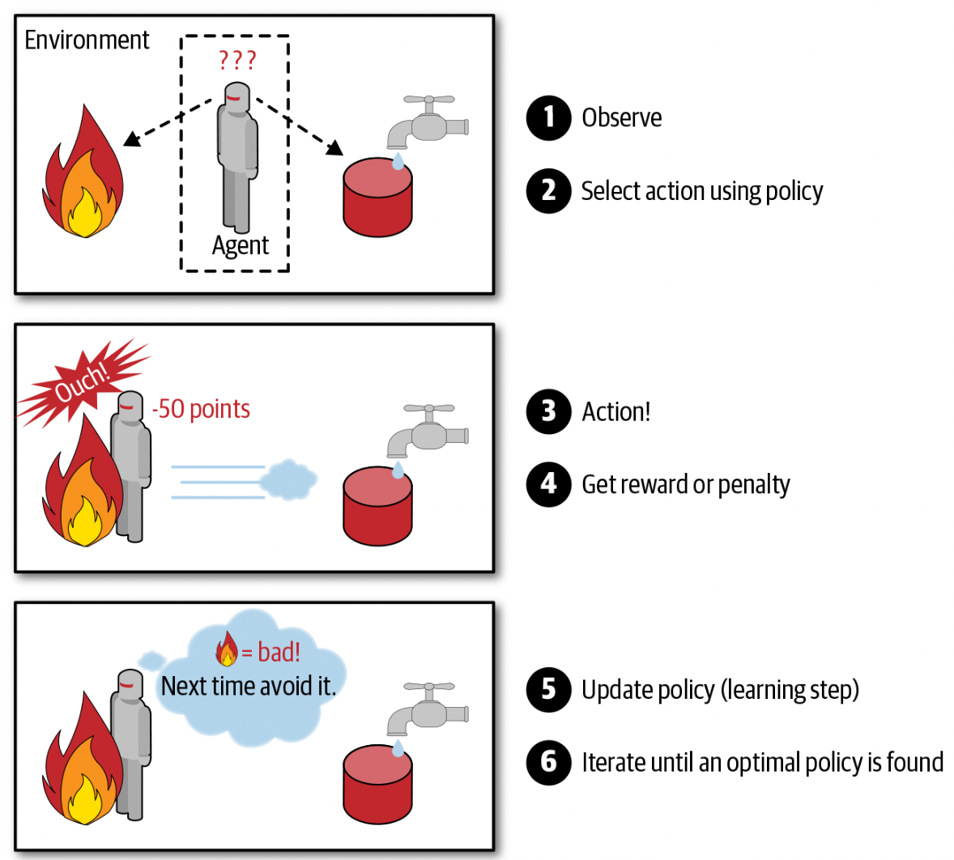
AI, Machine Learning and Deep Learning
Reinforcement Learning
Artificial Intelligence
Symbolic AI
Expert Systems
Machine
Learning
Fuzzy Logic
Neuro
Symbolic AI
Unsupervised
learning
Reinforcement
learning
Supervised
learning
Deep
Learning
[1] Géron, A. Hands-On Machine Learning with Scikit-Learn, Keras, and TensorFlow. 1150.
Notes:
Machine Learning :
Reinforcement Learning:
This is like how humans learn by trial and error.
Here you have a model called the agent. The agent interacts with the environment through actions. Here we can see the action of the agent is to touch the fire.
Based on the action of the agent we reward or penalize the agent.
It must learn by itself (without supervision) what is the best action to take at a given state. The actions to take at each state are specified through something called the policy. Through training the agent will learn the optimal policy that allows it maximize the cumulative rewards over time.

Slide 10
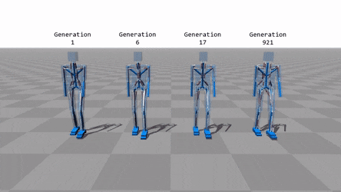
AI, Machine Learning and Deep Learning
Reinforcement Learning
Artificial Intelligence
Symbolic AI
Expert Systems
Machine
Learning
Fuzzy Logic
Neuro
Symbolic AI
Unsupervised
learning
Reinforcement
learning
Supervised
learning
Deep
Learning
Notes:
Many robots implement Reinforcement Learning algorithms to learn how to walk. DeepMind’s AlphaGo program is also a good example of Reinforcement Learning: it made the headlines in May 2017 when it beat the world champion Ke Jie at the game of Go. It learned its winning policy by analyzing millions of games, and then playing many games against itself. Note that learning was turned off during the games against the champion; AlphaGo was just applying the policy it had learned.

Slide 11
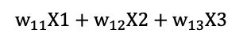
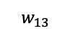
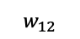
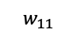
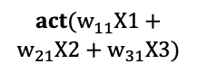
AI, Machine Learning and Deep Learning
A subset of machine learning based on artificial neural networks in which multiple layers of processing are used to extract progressively higher level of features from data (Oxford dictionary)
Artificial Intelligence
A simple neural network
Symbolic AI
Expert Systems
X1
h1
h3
X1, X2, X3 are features
Machine
Learning
Fuzzy Logic
X2
h5
y
h1, h2, h3, h4 are called
hidden nodes
h2
h4
X3
y is label
Neuro
Symbolic AI
Unsupervised
learning
Reinforcement
learning
h1
X1
Deep
Learning
$$w_{11}$$
Supervised
learning
$$act(w_{11}X1+$$
$$w_{21}X2+w_{31}X3)$$
X2
$$w_{12}$$
$$w_{11}X1+w_{12}X2+w_{13}X3$$
Act.
sum
Neural
networks
Conv Nets
$$w_{13}$$
X3
RNN
Training a neural network is simply learning the appropriate weights

Slide 12
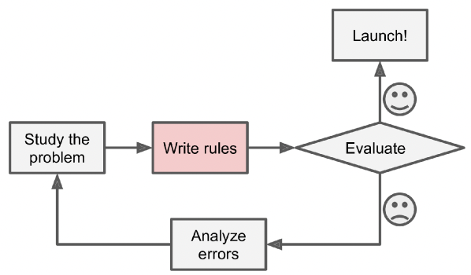
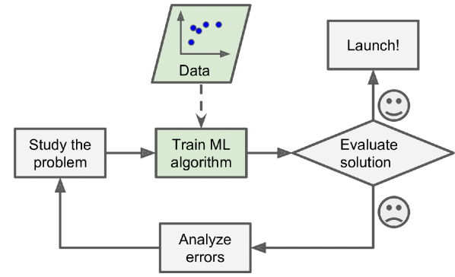
Why Machine Learning is useful ?
Simplified traditional program workflow
Simplified machine learning program workflow
Requires defining conditional statements
No hard coded rules, model learns patterns from the data.
Building model takes a significant amount of time.
Building model is fast due to well documented python libraries
Must rewrite model code to incorporate new data.
A well trained model is generalizable to perform a task on new data.
Cannot solve problems with no analytical or numerical solution.
Can perform complex tasks such as image recognition, language translation and can generate new insights from the data.
[1]. Géron, A. Hands-On Machine Learning with Scikit-Learn, Keras, and TensorFlow. 1150.

Slide 13
Rapid Fire
1. What is a feature ?
2. What is a label ?
3. What is a dataset ?
4. Difference between supervised and unsupervised learning ?
5. What is reinforcement learning ?

Slide 14
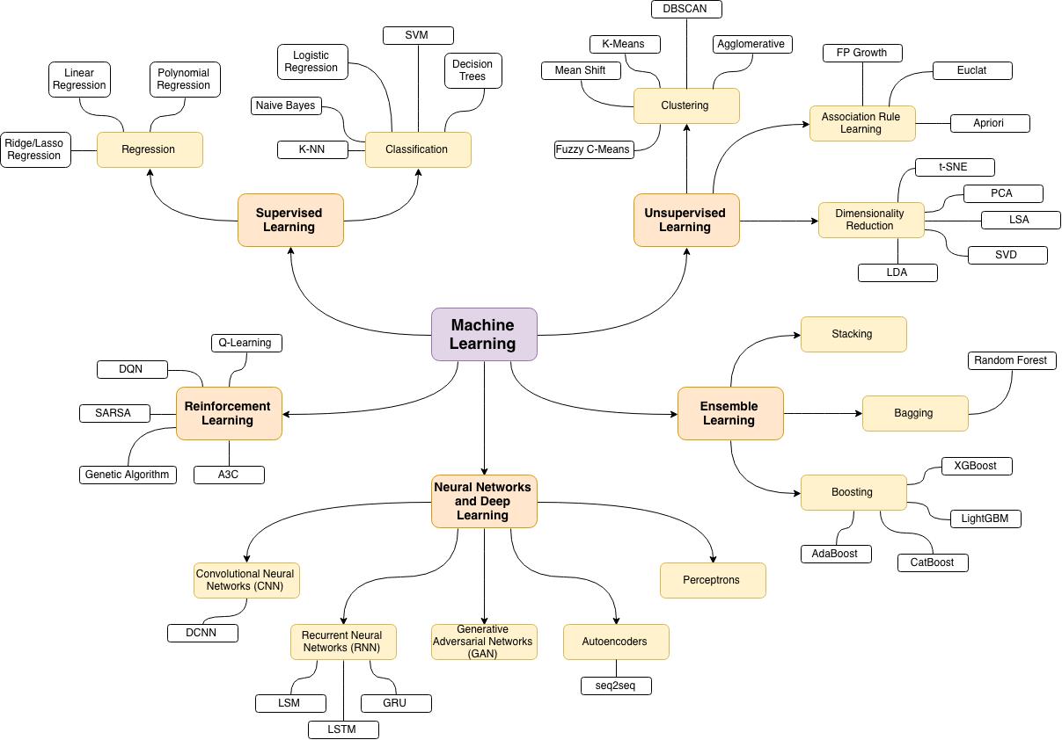
Treasure trove of machine learning algorithms
https://github.com/trekhleb/homemade-machine-learning

Slide 15
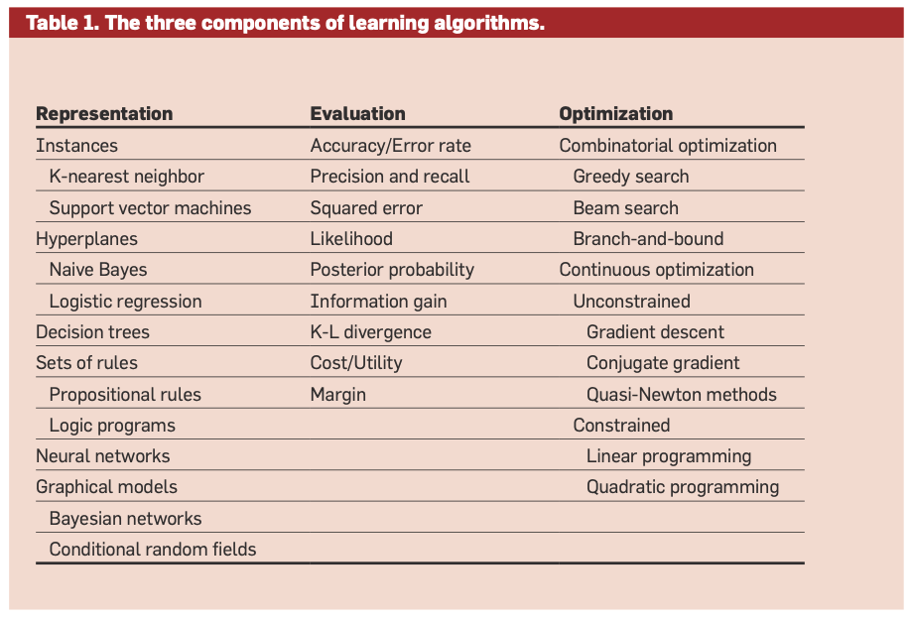
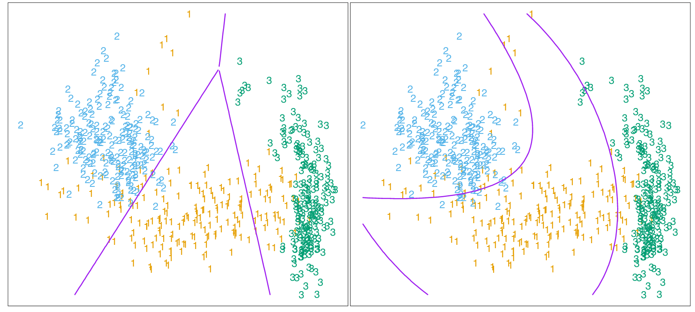
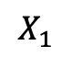
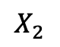
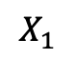
Machine Learning = Representation + Evaluation + Optimization
1. Representation
Is the space of allowed models (the hypothesis space)
$$X_{2}$$
$$X_{1}$$
$$X_{1}$$
[1] Domingos, P. A few useful things to know about machine learning. Commun. ACM 55, 78–87 (2012).
Notes:
Each learning algorithm has its own representation of the problem. Some representations may be better than others which makes learning easier. For example in the figure shown we have 3 classes (1,2,3) the goal of the machine learning algorithm is to find a decision boundary (represented in purple) that is able to to segregate your classes. For the right hand plot we see that if we use only the given two features and our model representation is a linear function then we learn the optimal linear decision boundaries however if the model representation includes higher order non linear functions then we can learn more complex decision boundaries that are able to segregate your classes much more better. In this case we have a quadratic decision boundary.
Note
-Here both the models use linear discriminant analysis to find linear decision boundaries but for the plot on the right we expand the 2D feature set (X1, X2) to a 5D feature set(X1,X2,X1^2,X1X2,X2^2) and then fit a linear decision hyperplane to segregate the classes in the 5D space which corresponds to fitting a quadratic function in the 2D space.
-This is a classic example that shows how you represent the data is as important as selecting your model. Hence representation encompasses both data representation + model representation

Slide 16
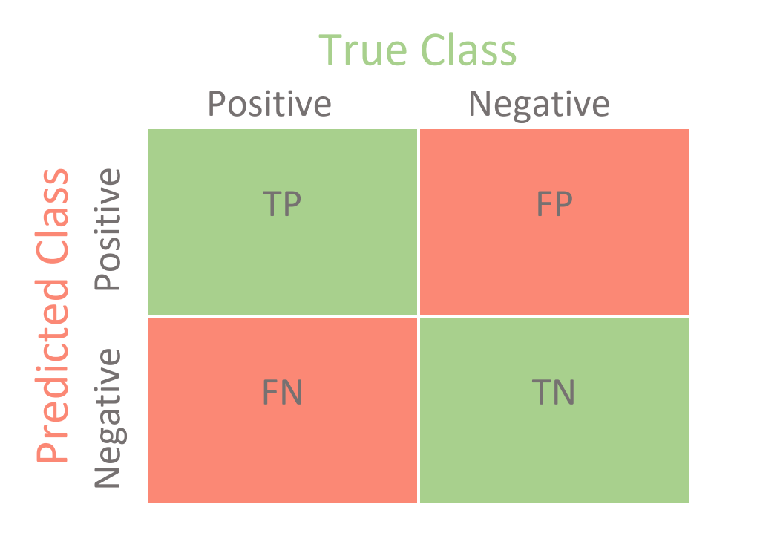
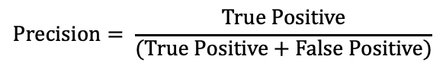
Machine Learning = Representation + Evaluation + Optimization
2. Evaluation
Scoring/Objective function to distinguish a bad model from a good model
$$Accuracy= \frac{True Positive+True Negative}{(True Positive+True Negative+False Positive+False Negative)}$$
$$Precision= \frac{True Positive}{(True Positive+False Positive)}$$
3. Optimization
Method for searching for the best performing model as evaluated by the evaluation function.
[1] Domingos, P. A few useful things to know about machine learning. Commun. ACM 55, 78–87 (2012).
Notes:
- In the previous example we saw visually that one model was performing better at segregating the classes compared to the other. We can also express how much better quantitatively by using some kind of metric. This brings us to the second component of a machine learning algorithm which is evaluation.
- Not only do evaluation functions help us determine which model is better performing compared to several other different machine learning models but are also used to find the optimal model within a chosen model type to perform a certain task and this is done using the third component of a machine learning algorithm which is called optimization.
To search the hypothesis space/model space efficiently to find the best model representation we use optimization algorithms that are guided by the scoring/objective functions to find the optimal model representation for a given task.

Slide 17
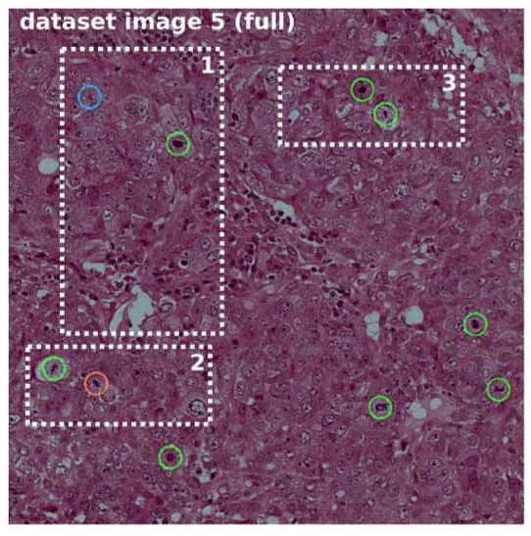
Machine Learning in Biology
Accurate classification of diseases and disease subtypes [2]
1. Clustering different breast cancer types [3]
Current gold standard involves using PAM50 to classify breast cancer into 4 different sub categories based on expression of 50 marker genes.
However there is still significant heterogeneity in each cluster.
Unsupervised learning approach was used to cluster breast cancer
1.2. Mitosis detection by using CNN [4]
Convolution Neural Network (CNN) to count the number of mitotic divisions which is highly correlated with disease outcomes in histological images.
[1] Greener, J. G., Kandathil, S. M., Moffat, L. & Jones, D. T. A guide to machine learning for biologists. Nat Rev Mol Cell Biol 23, 40–55 (2022). (A very good review of different ML methods and how to start using ML in you research problem)
[2] Ching, T. et al. Opportunities and obstacles for deep learning in biology and medicine. J. R. Soc. Interface. 15, 20170387 (2018) (Thorough review of applications of deep learning to biology and medicine)
[3] Tan, J., Ung, M., Cheng, C. & Greene, C. S. UNSUPERVISED FEATURE CONSTRUCTION AND KNOWLEDGE EXTRACTION FROM GENOME-WIDE ASSAYS OF BREAST CANCER WITH DENOISING AUTOENCODERS. in Biocomputing 2015 132–143 (WORLD SCIENTIFIC, 2014). doi:10.1142/9789814644730_0014.
[4] Cireşan, D. C., Giusti, A., Gambardella, L. M. & Schmidhuber, J. Mitosis Detection in Breast Cancer Histology Images with Deep Neural Networks. in Medical Image Computing and Computer-Assisted Intervention – MICCAI 2013 (eds. Mori, K., Sakuma, I., Sato, Y., Barillot, C. & Navab, N.) vol. 8150 411–418 (Springer Berlin Heidelberg, 2013)
Notes:
Cluster breast cancer patients
PAM50 approach is used to classify breast cancer based on expression of 50 marker genes to divide patients into 4 sub categories.
However substai
Mitosis detection by using CNN
Cyan model doe not detect mitosis, green model correctly predicts mitosis (True Positive), red model falsely predicts mitosis (False Positive)
Model can detect with 88% precision

Slide 18
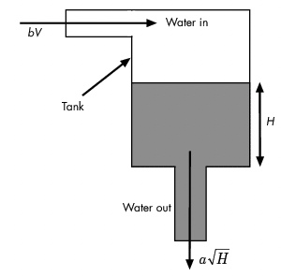
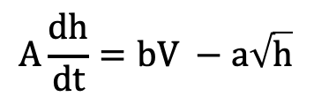
Machine Learning in Process Control
Controllers must be retuned every time there is :
Change in operating conditions of process
Encounters new disturbances
Change in process dynamics due to fouling, catalyst deactivation etc.
Example problem [1]
Use RL to determine PI controller gains to control pump to maintain water at specified level
Process well understood and
easy to model disturbances
Gain Scheduling
Process complex and
tough to model disturbances
Adaptive Control
Systems
Reinforcement Learning is a type of adaptive control system.
$$A\frac{dh}{dt}=bV −a\sqrt{h}$$
[1] Reinforcement learning for control systems
[2] Water tank Simulink model
[3] Use RL to predict controller gains
[4] Use RL to replace PI controller
[5] Creating water tank reinforcement learning environment
Notes:
Examples of changes in operating conditions change in product flow rates, product compositions
Examples of new disturbances are environmental disturbances such as rain storms, high speed winds, disturbances in feed composition
Examples in change of process dynamics are : heat exchanger fouling, catalyst deactivation
Gain scheduling :
uses family of non linear controllers each of which provides satisfactory control for a different operating point of the system. (Page 290)
Piece wise constant controller gain that varies with error signal
V is voltage applied to pump
‘b’ is constant related to input flow rate based on voltage applied
’a’ is constant related to output flow rate based on height of water already in the tank
A is cross section of tank

Slide 19
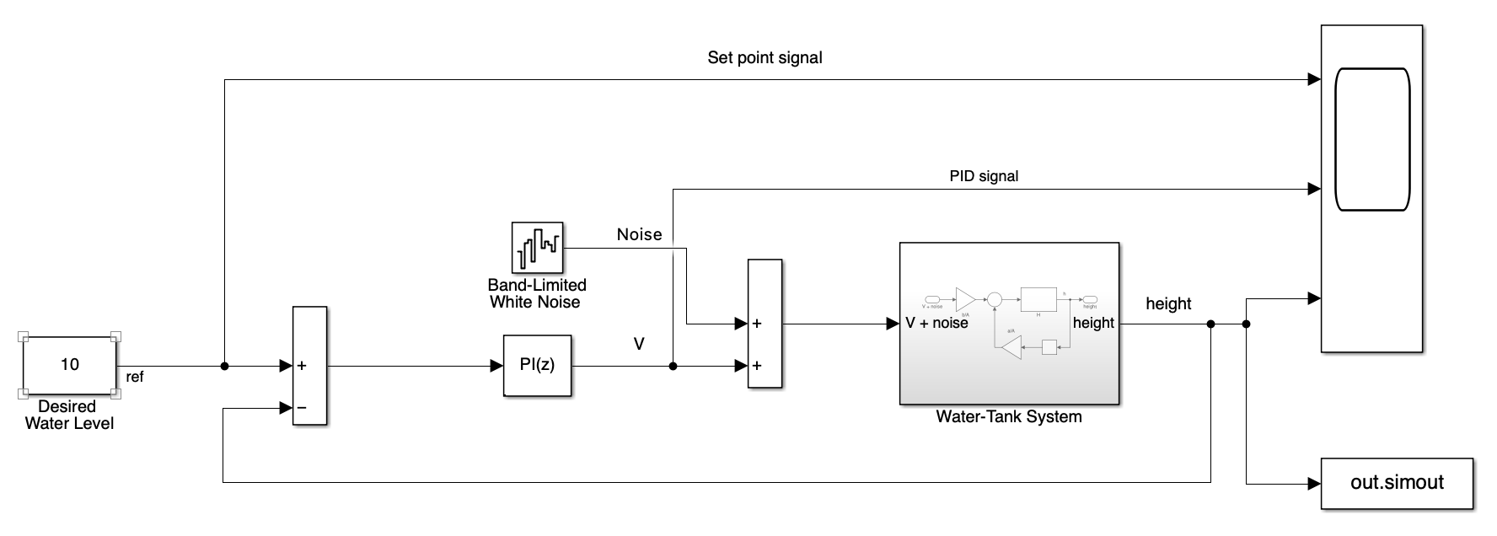
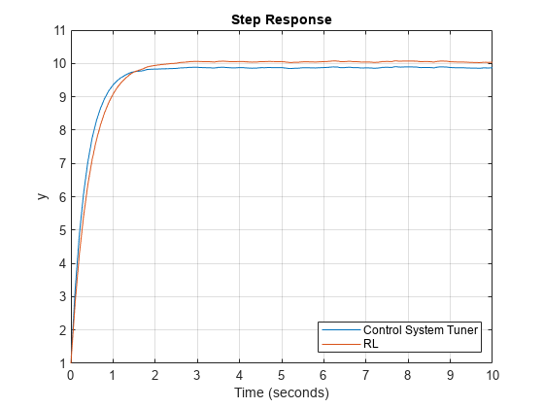
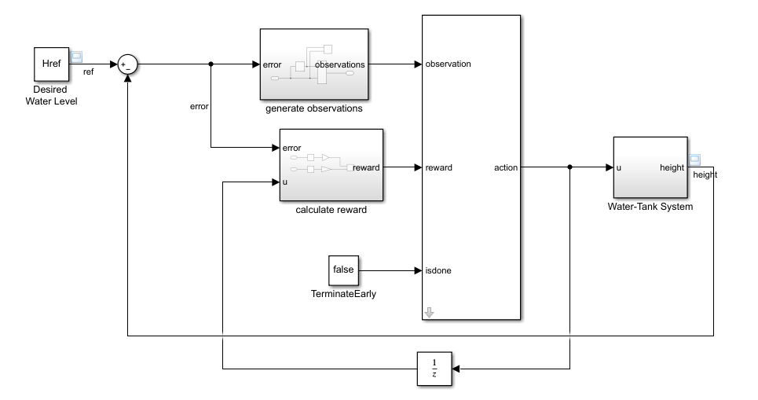
Feedback controller with Water-Tank system
RL agent acting as PI Contoller
Notes:
RL agent is a neural network is a one layer neural network that emulates the role of PI contoller : $K_{p}∗e\left(t\right)+K_{i}\int{e\left(t\right)dt}$
We learn the weights of the actor using a twin delayed deep deterministic policy gradient (TD3) Reinforcement learning algorithm which is a special kind of actor critic reinforcement learning.
In simple words
The actor is a neural network that performs the action on the environment. It learns the optimal policy.
The critic is also a neural network that provides feedback to the actor on how good the selected action is. It provides the value of the selected action at a given state of the system.
In the above RL algorithm we have two critics (twin delayed)
‘deep’ stands for the fact we are using neural networks to model our actor(policy function) and critic (value functions)
‘Deterministic policy gradient’ essentially means we are operating in a continuous action space (i.e volatege is not discrete but can take a range of values)
The amount of error tells us how far away we are from the desired state which is when height of water in tank is equal to the desired water level.
Reward is calculated based on action taken and error obtained due to that action.

Slide 20
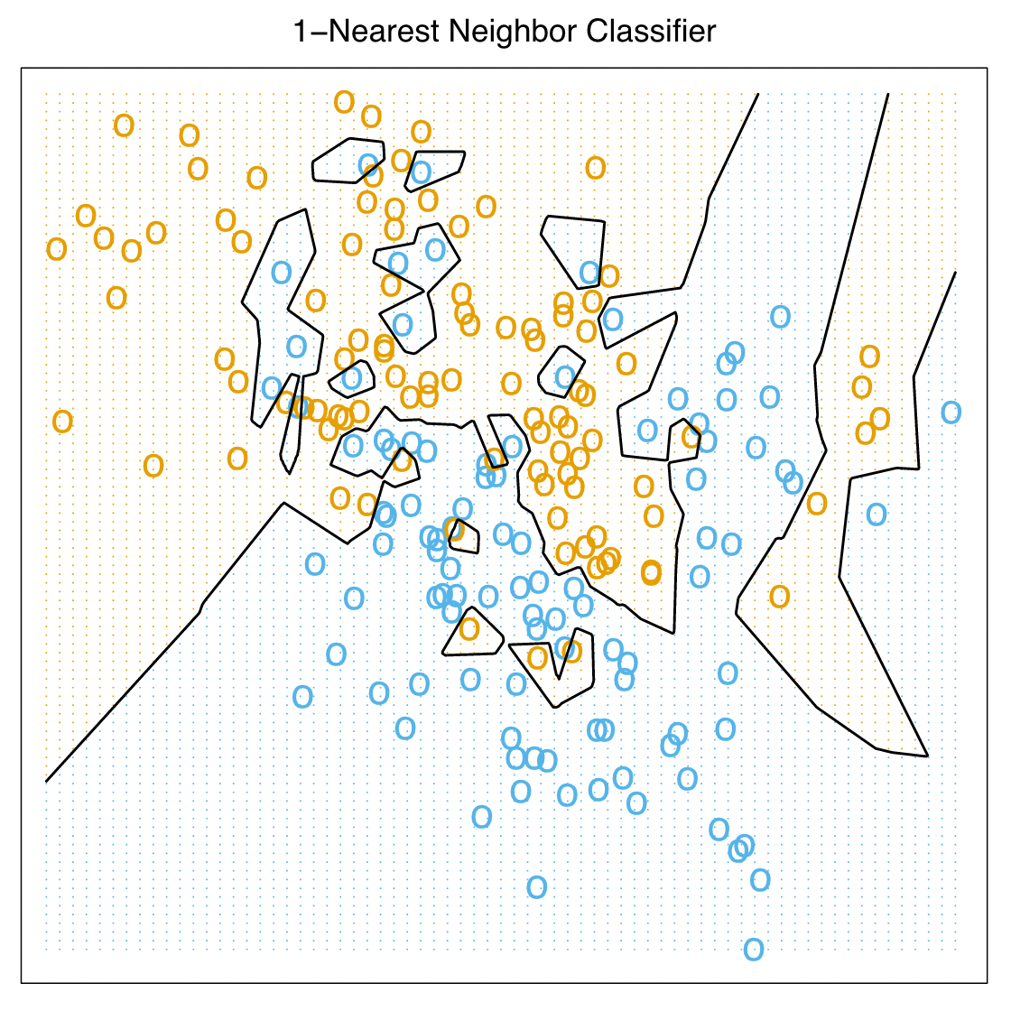
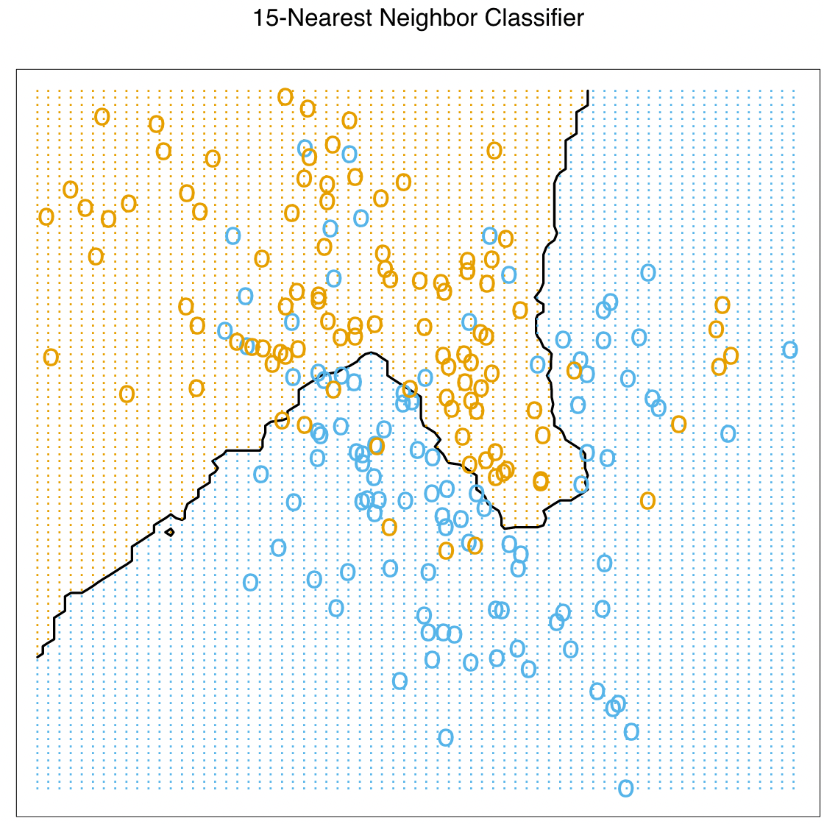
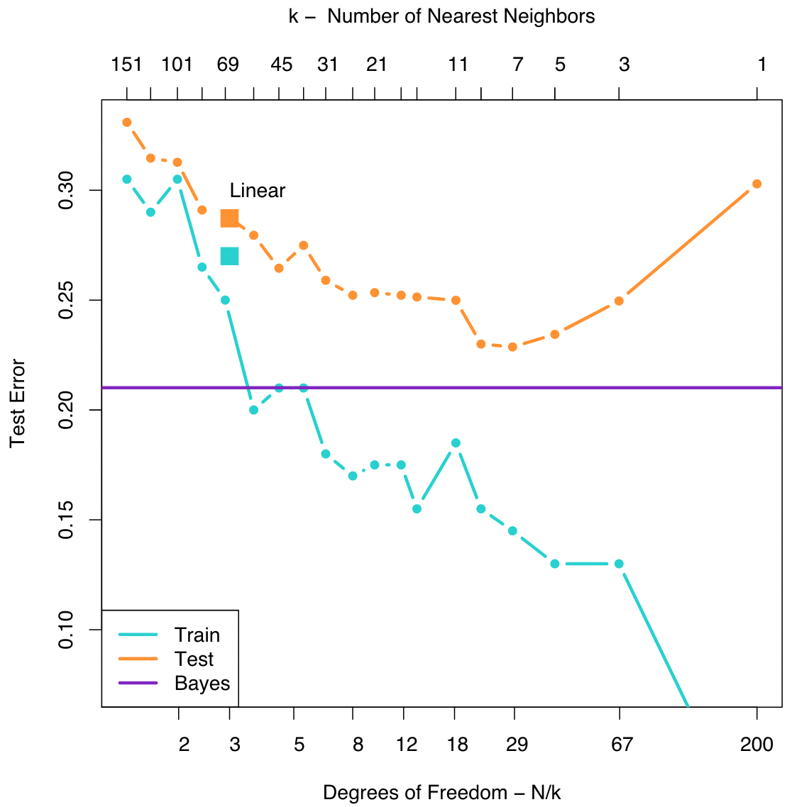
What are some challenges in training machine learning models ?
Challenges related to data collection
1. Insufficient quantity
2. Non representative
3. Poor quality data
4. Irrelevant features (GIGO)
Challenges related to training machine learning model
Overfitting on training data
Underfitting on training data
Bias Variance Tradeoff
1. Tibshirani, S. & Friedman, H. Valerie and Patrick Hastie. 764.
Notes:
Non –representative : Training data must be representative of new data you want to generalize to !
Irrelevent features : Features that are not correlated with the output, have too much noise, have the same value for all the datapoints are not so much useful for performing a classification or regression task.
K-Nearest Neighbours :
Points of similar class group together.
Here based on each datapoint in the training set we find the ‘k’ nearest neighbours.
In case of overfitting we consider only the 1st nearest neighbors we get this very complex decision boundary function that fits to the noise in the data. This is called overfitting.
By considering more nearest neighbors we get a much more cleaner decision boundary that tries to is close to the optimal decision boundary for separating the blue and orange classes.
We can find the optimal decision boundary by varying our model hyperparameter which is the number of nearest neighbors and compare the classification test error we get in each case.
Higher the value of ‘k’ the more we are approximating our decision boundary until eventually it becomes linear.
By decreasing the value of ‘k’ even further we risk at the chance of overfitting due to increased model complexity.

Slide 21
1. Identify the problem you want to solve
4. Select a learning algorithm
Based on type of problem, amount of data available and interpretability
Try a combination of different models
Preprocessed Dataset from 2
Data
Available?
NO
TRAIN SET
5. Train model on train set
TEST SET
YES
6. Test model accuracy on test set
2. Understand the data
What are the different data types ?
Number of data points ?
Are there any missing data ?
What is the distribution of your features and labels ?
Tune model hyperparameters
Generate data
7. Analyze model errors
Check for overfitting or underfitting
Compare your results with others in the community
NO
3. Create a data pipeline
Write scripts that can automate the process of extracting data
If categorical variables are present use a proper encoding scheme.
Standardize the data.
Satisfied with results ?
Change model ?
Revisit the problem (Go to step 1)
NO : (
NO : (
YES
YES !
Machine Learning project workflow
8. Publish Your model !

Slide 22
Resources to start on your ML journey !
Textbooks
Machine Learning : A Probabilistic Approach by Kevin P. Murphy
Excellent book that dives right into the math of some common machine learning algorithms
Elements of Statistical Learning by Trevor Hastie and Robert Tibshirani and Jerome Friedman
A more advanced level introduction to machine learning. Skips a lot of the derivation parts. (Not for faint hearted !)
Hands on Machine Learning with Scikit-Learn, Keras and Tensorflow by Aurelien Geron
Great book to start with ! Guided tutorials and explanations to building and training machine learning models without diving too much into the math.
Deep Learning with Python by Francois Chollet
https://www.deeplearningbook.org by Ian goodfellow and Yoshua Bengio and Aaron Courville
Excellent book to follow for building and training neural networks !
https://developers.google.com/machine-learning
Neural net visualization
Youtube video links by 3Blue1Brown on Deep Learning
But what is a neural network ? | Chapter 1, Deep Learning
Gradient Descent, how neural networks learn | Chapter 2, Deep Learning
What is backpropagation really doing ? | Chapter 3, Deep Learning
Backpropagation calculus | Chapter 4, Deep Learning
Courses at Johns Hopkins for Upper Level Undergraduates
EN.601.475 (01) Machine Learning -> CSE
EN.540.405 (01) Machine Learrning -> ChemBE
EN.601.475 (01) Machine Learning for Medical Applns -> ECE
EN.540.405 (01) Machine Learning : Deep Learning -> CSE
Notes:
Robert Tibshirani is a professor in the department of Statistics and Biomedical data science at Stanford University.
Francois Chollet creator of Keras deep learning library and main contributor to Tensorflow
Ian goodfellow creator of Generative Adversarial Network (GAN).

